Slide 1

Eye Optical clinic
Harshil patel

Slide 2

Eye Optical Clinic
University Name: Charutar Vidya Mandal
Collage: Semcom
Academic Year: 2024-25
Name: Raghav V Patel
Roll No: 60
Class: TYBCA - V

Slide 3
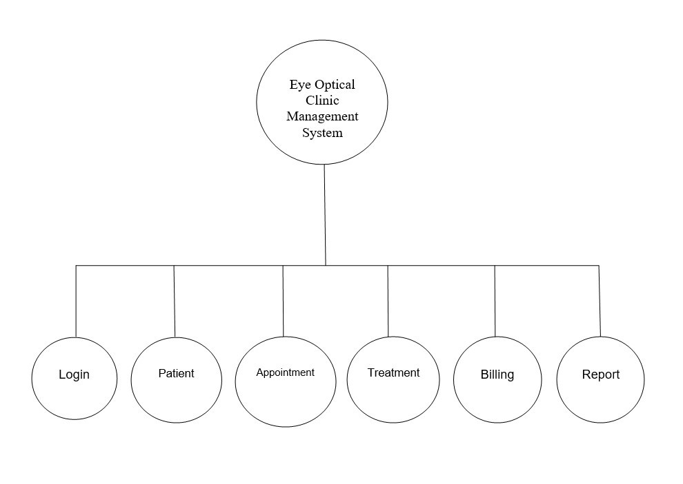
Project Short Info:
Proposed System alters Existing System’s Drawbacks like :
Manual on paper entries for every process
Limited Data Storage and Difficulties in Data accessibility
Difficulty for Making Decisions from past data (take too much time and efforts)
Difficulty in Managing of Inventory because it was a manual task, Doctor had to take care of each detail-data either patients or Treatment.
Proposed System automates manual processes and make tasks more easier and simpler than existing manual - paper-based system.
Now Doctor of clinic can control time, cost, human power and resources and focuses more on activities for development of the clinic.
Requirements for proposed system :
Windows Operating System with basics specifications.
Should have Visual Studio for modification also for perfect use of the system.

Slide 4
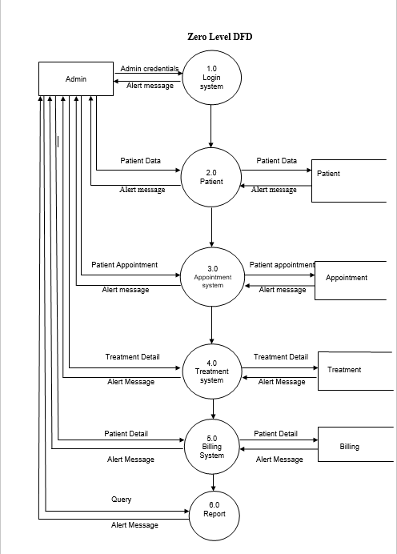
Working of the System:
First user needs login credentials for make use of the system.
Then user will be redirected to dashboard at there he/she will find multiple choices like either want to add records of patient or Appointment data or Treatment or other options.
Appropriate Forms will be visible after selection of any object.
Almost all forms have connection with database. according to activities that user made, database also automatically get updated for example after successfully insertion of patient form data, patient database also get updated automatically.
Manager of the shop now not need to keep separate systems for all the processes, he/she get all processes done through using of this visual basic based windows application.
Only Requirement is User must have a windows based operating system and people that knows basic computer operations for making use of system.

Slide 5
Relationship between Tables
System follows normalization approach for storing data into database.
By establishing Relationships between tables, system will reduce redundancy of data.
User does not need to add full details again and again just get ID of the vendor that user want.
Explanation: In table Patient_name and Address of Patient both jointly make a unique entry and associated ID will be worked as Primary key/reference for purchase table, in purchase table there is ID through which we can fetch full details of Patients from Patients details
Same goes with Treatment_ID and Appointment_ID for other tables

Slide 6
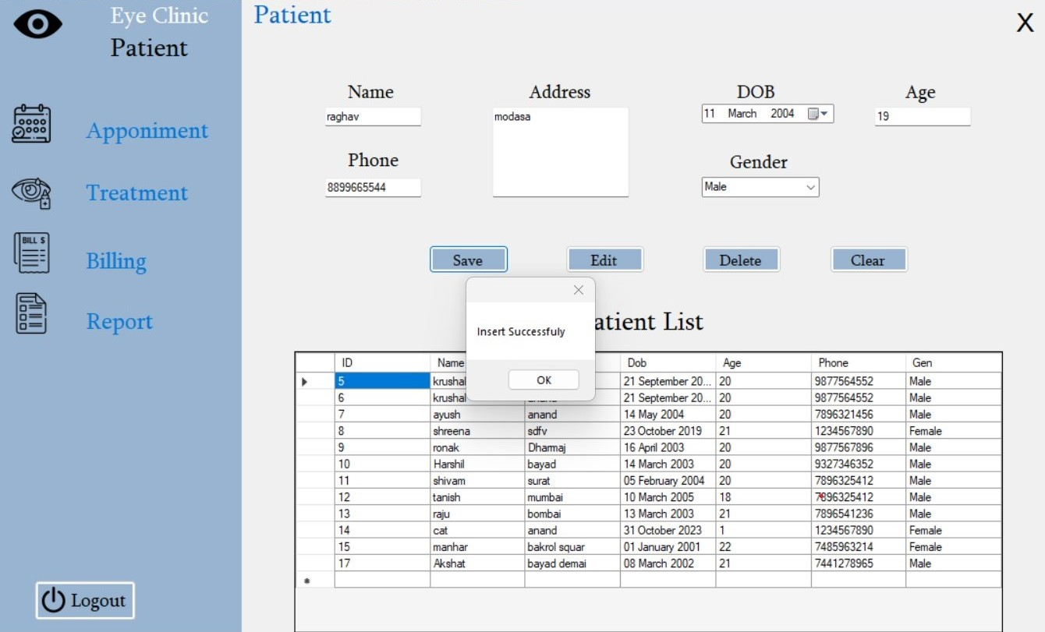
Patient Information:
This page is patient Information form
This is Store the patient detail’s and it has edit the info. And delete.

Slide 7
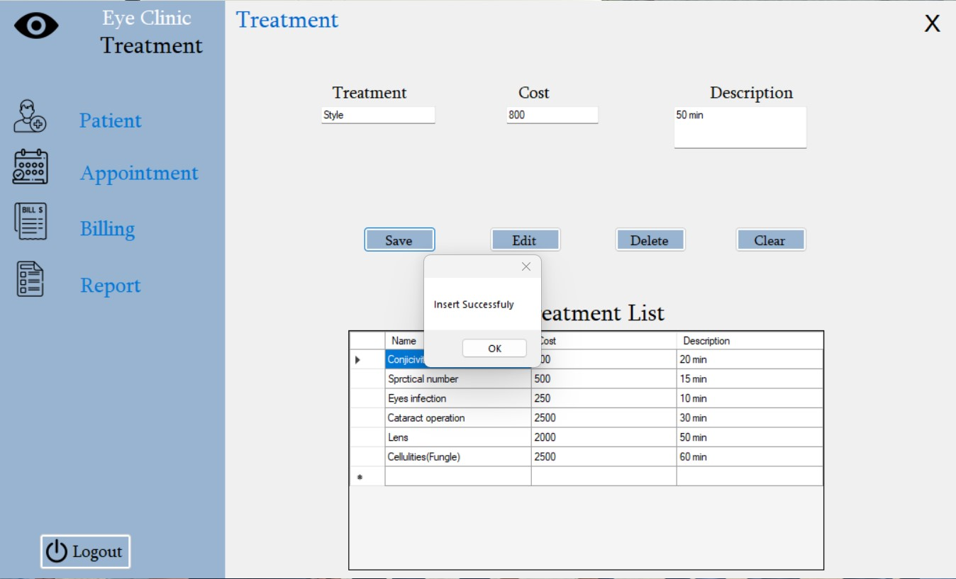
Treatment Form:
This page is treatment form
This is Store the Treatment detail’s and
we can edit the cost and delete the detail’s.

Slide 8
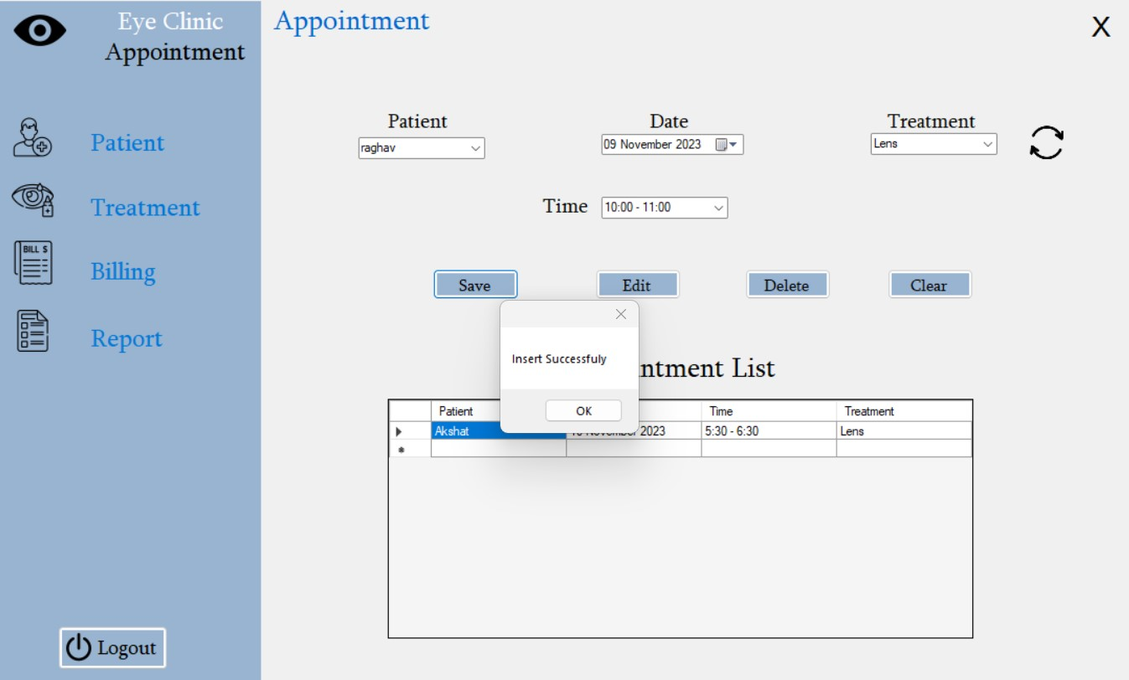
Appointment Form:
This page is appointment form.
This is Store the Appointment detail’s and
we can edit the Time,Date.

Slide 9
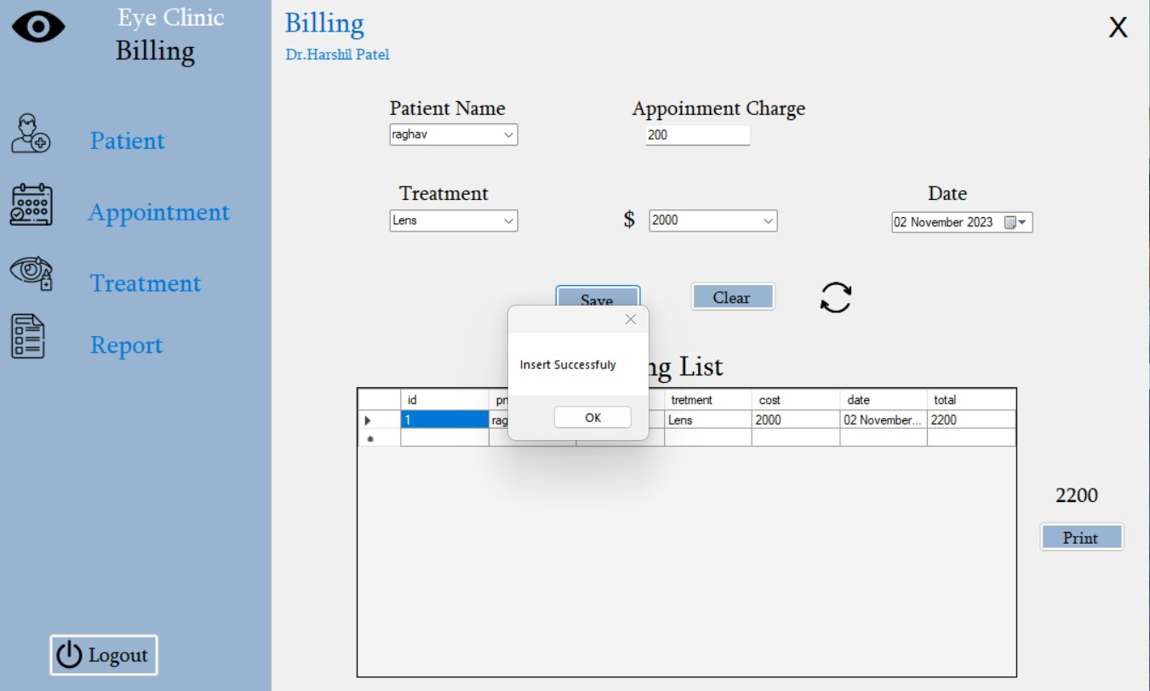
Billing Form:
This page is billing form.
This is Store the Billing detail’s and
we can generate the bill in PDF format.

Slide 10
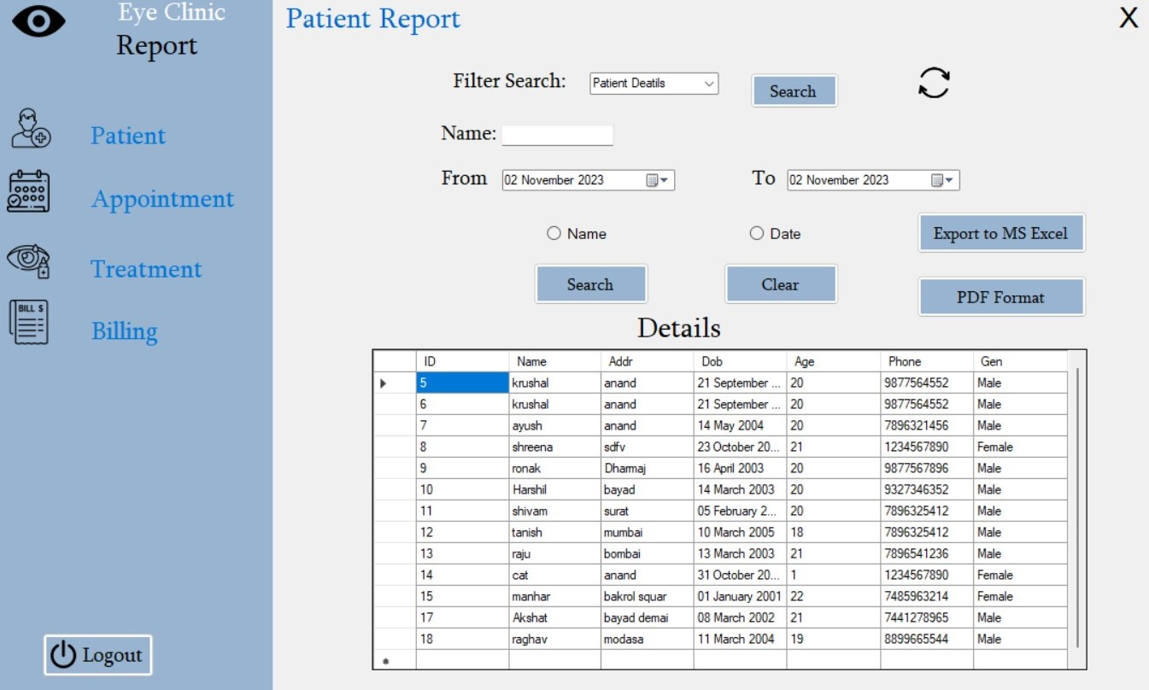
Report Form:
This page is report form.
We can find report in date wise and name wise.
By filter search combo box you can find Multiple report Info.
This is fetch the Report detail’s and
we can generate the report in PDF format and Excel format.

Slide 11
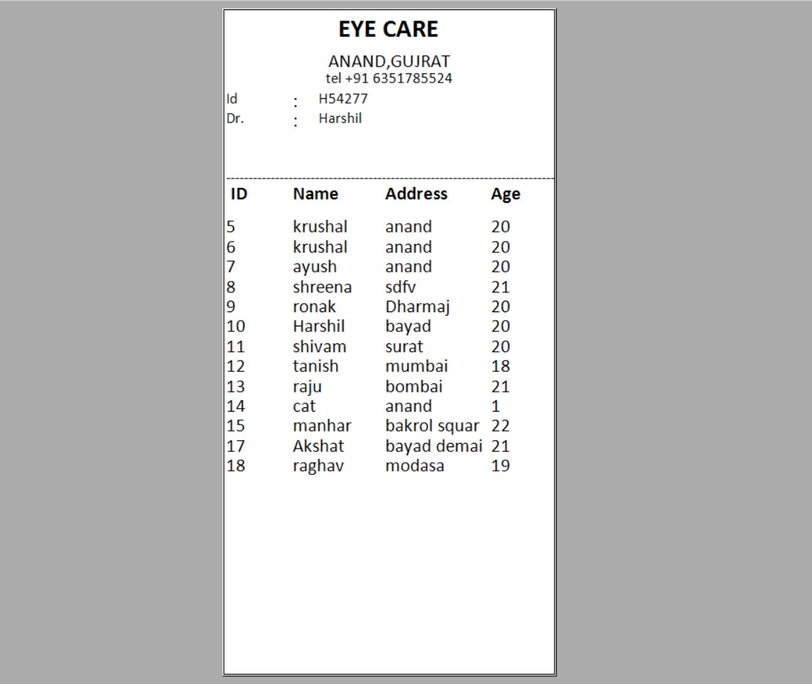
Report in PDF Format:

Slide 12
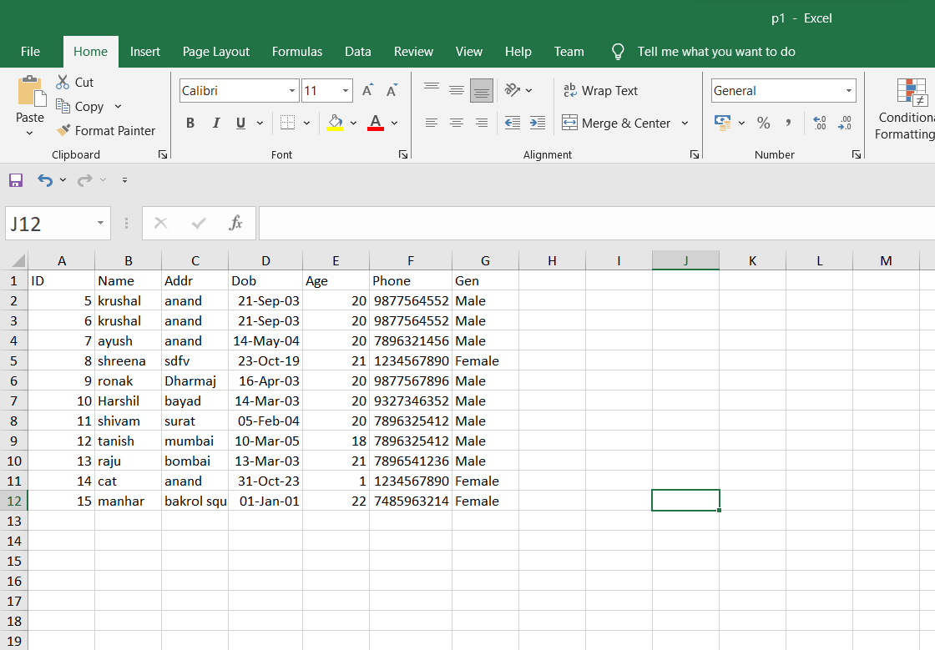
Report in Excel Format:

Slide 13
Thank You

